Slide 1


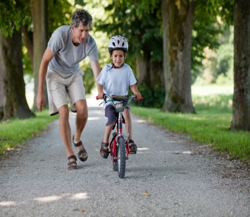
1
Unit 2 Section A
A child’s clutter awaits an adult’s return
FOREIGH LANGUAGE TEACHING AND RESEARCH PRESS
AIR FORCE ENGINEERING UNIVERTISY
Notes:
1

Slide 2
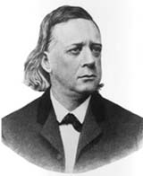
1
2
Loving parents, loving children
UNIT
There is no friendship, no love, like that of the parent for the child.
— Henry Ward Beecher
(American clergyman, social reformer)
While we try to teach our children all about life, our children teach us what life is all about.
— Angela Schwindt
(American home-schooling mom)
Notes:
2

Slide 3

^{Section A}
1
2
Loving parents, loving children
UNIT
A child’s clutter awaits an adult’s return
To talk about the love between the parents and children
Objectives
To understand the love between the mother and the daughter in the text
To apply the phrases and patterns
To write an essay creatively based on the understanding of the text

Slide 4
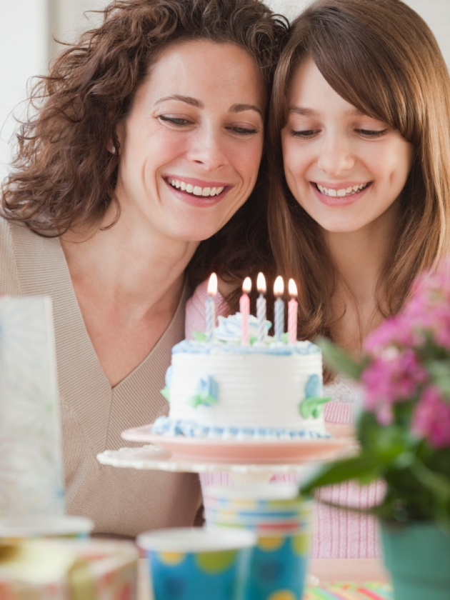




A child’s clutter awaits
an adult’s return
Section A
Contents
Warming-up activities
Text study
Language application
Summary

Slide 5



A child’s clutter awaits
an adult’s return
Section A
Warming-up activities
Lead-in
Pre-reading activities

Slide 6
Lead-in
Survey: How close are you and your parents?
Check (√) the statements which are true for you.
I have been missing my parents a lot since I left for college.
I often chat with my parents.
I like sharing my joys and sorrows with my parents.
I always remember my parents’ birthdays.
I know about my parents’ hobbies.
My parents allow me to make my own decisions.

Slide 7

Lead-in
Short Answer Question
To what extent are you close to your parents?
Tips
be like friends;
never keep secret from them;
ask them for advice;
give me directions about life …

Slide 8
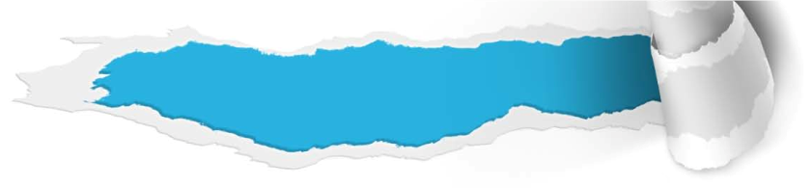

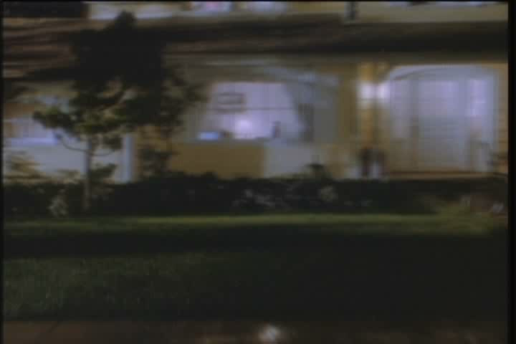
Pre-reading activities
Watch and Talk
Watch a video clip and answer the following questions.
1. What happened to the father and the son?
2. Is there any conflict or disagreement between you and your parents? And what should we do to settle the conflict or disagreement?

Slide 9

Pre-reading activities
Watch and Talk
1. What happened to the father and the son?
Tips
enjoy the baseball game / dance to one’s favorite music / be too loud for one to put up with … / go upstairs / shout to sb. that … / rather than do as sb. tells / bring one’s things into sb.’s room / play the electric guitar / at the top of the speaker’s volume / make one’s blood boil

Slide 10
Pre-reading activities
Watch and Talk
2. Is there any conflict or disagreement between you and your parents? And what should we do to settle the conflict or disagreement?
Tips
1) Keep our minds open to our parents;
2) Treat our parents the way we want them to treat us;
3) Make friends with our parents;
4) Learn to be responsible for our actions;
5) Be sure to show love to our parents in different forms.
...

Slide 11



Pre-reading activities
Compound Dictation
Listen to a short passage concerning the love for the mother and fill in the missing information.
Let us take a moment of the time just to pay tribute and ________________to the person called MOM though some may not say it openly to their mother. There’s no substitute for her. _______ every single moment. Though at times she may not be the best of friends, she may not ________ your thoughts, she is still your mother!
show appreciation to
Cherish
agree to

Slide 12
Pre-reading activities
Compound Dictation
Listen to a short passage concerning the love for the mother and fill in the missing information.
She will be there for you; to listen to your woes, your brags, your __________, etc. Ask yourself “Have you _________ enough time for her, to listen to her ‘blues’ of working in the kitchen, her _________?”
frustrations
put aside
tiredness

Slide 13
Pre-reading activities
Compound Dictation
Listen to a short passage concerning the love for the mother and fill in the missing information.
Be tactful, loving and still show her due _______, though you may have a different view from hers. Once gone, only fond _________ of the past and also regrets will be left.
respect
memories

Slide 14

Pre-reading activities
Compound Dictation
Listen to a short passage concerning the love for the mother and fill in the missing information.
Don’t ______________ ed the things closest to your heart. Love her more than you love yourself. Life is ____________ without her.
take for granted
meaningless

Slide 15

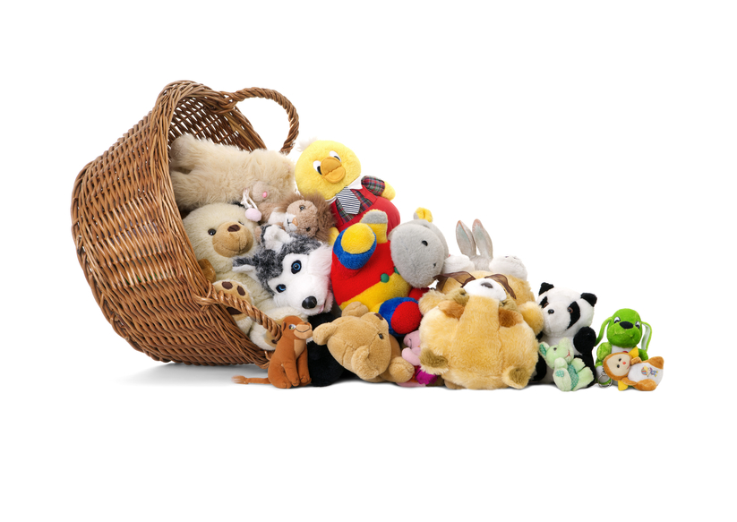
A child’s clutter awaits
an adult’s return
Section A
Text study
Main idea & structure
Language focus
Critical thinking

Slide 16
Main idea & structure
Main ideas of the parts
Tips
The text depicts a mother’s responses to her daughter’s fight for independence through detailed description of the mess left behind by the daughter.
Notes:
16

Slide 17

Main idea & structure
Main ideas of the parts
Disagreements between the mother and the daughter (Paras.1-3):
Daughter
Mother
Tips
Tips
a truck, large &
expensive;
a practical car with
good gas efficiency,
easy to park
an adult, 18 years
old
watch cartoons,
doubt

Slide 18
Main idea & structure
Main ideas of the parts
How does the mother feel towards her daughter’s leaving home? (Para. 4)
glad, sad, frustrated, worried …
Tips
I’m ____ she’s gone. It means she made it, and that I’m ____________18 years of responsibilities. And yet I _______ if she could take good care of herself. (Para. 4)
glad
finally free of
wonder
Notes:
18

Slide 19

Main idea & structure
Main ideas of the parts
Part I (Paras. 1- __)
4
The daughter is leaving home for independence and the mother feels ____ on the one hand and expresses her _____________ on the other.
glad
concern / doubt

Slide 20
Main idea & structure
Main ideas of the parts
She left a mess. (Para. 5)
Mess in the bathroom
Mother’s response
Tips
Tips
an embarrassment of …, damp towels, rusted shaving blades, hair in the sink, empty tubes of toothpaste
dump,
sweep,
clean
Notes:
20

Slide 21
Main idea & structure
Main ideas of the parts
She left a mess. (Paras.6-12)
Mess in the bedroom
Mother’s response
Tips
Tips
under her bed, desk drawers, be filled with, filed by year and subjects, books, clothes, …
pack … into a box, stack …onto a single shelf, separate … into two piles, turn … into …
Notes:
21

Slide 22
Main idea & structure
Main ideas of the parts
Part II (Paras. _ - _ )
5
12
The daughter ____________ in her rooms and the mother ____________ the rooms.
leaves a mess
straightens up

Slide 23
Main idea & structure
Main ideas of the parts
What catches the mother’s attention under the bed? What’s inside it? (Para.13)
Tips
A large envelope marked with “DO NOT THROW AWAY”.
There are family photographs, letters, greeting cards, and love notes from the parents.
Notes:
23

Slide 24
Main idea & structure
Main ideas of the parts
Change of the mother’s emotion: (Paras.13-15)
emotional, understanding
Tips
emotional
Suddenly, I feel very _________. (Para.13)
As I read through the cards and notes, I think maybe the truck ___________________, after all. Maybe it ______________________ in a big world. (Para.15)
wasn’t such a bad idea
helps her to feel less small
Notes:
24

Slide 25
Main idea & structure
Main ideas of the parts
What does the mother do finally and how does she feel? (Paras. 16-22)
Tips
I reverse myself and bring back the garbage bags …, (Para.16)
Tokens of her childhood will await her. So will we, with open arms. (Para.22)
expectant
Notes:
25

Slide 26
Main idea & structure
Main ideas of the parts
Part III (Paras. __ - 22)
13
After the mother finds a large envelope with all the memorable things the parents gave to the daughter, the mother’s attitude ______________ es completely.
changes/reverses

Slide 27
Main idea & structure
Main ideas of the parts
Watching the daughter leaving home for independence, the mother feels glad and _______________________. The girl leaves a mess in her rooms, and the mother spends quite a long time ______________ the rooms. When the mother finds a large envelope containing all the memorable things the parents gave to the daughter, the mother ________________ her attitude.
free of the responsibilities
straightening up
changes/reverses

Slide 28
Main idea & structure
Structure of the text
General situation & my responses
(Paras. 1 - 4)
My daughter is gone in her large and expensive truck, declaring that she is an adult.
I’m glad she’s gone and I’m free from years of responsibilities for her.

Slide 29
Main idea & structure
Structure of the text
General situation & my responses
The mess left by the daughter and my responses (Paras.5-12)

Slide 30
Main idea & structure
Structure of the text
I put the garbage into the bags and dump drawers, sweep shelves and clean the sink. (Para.5)
She leaves a mess in her bathroom. (Para.5)
The bedroom is in a mess, too and desk drawers are filled with school papers. (Para.6)
I pack the desk contents into a box. (Para.6)
The mess left by the daughter and my responses (Paras.5-12)
There are various unsorted books on her desk. (Para.7)
I stack them onto a bookshelf. (Para.7)
Clothes and other things are everywhere in the bedroom. (Paras.8-11)
I separate the clothes into two piles and wash the bedding. (Paras.8-11)
I will turn her room into a crafts room or guest room. (Para.12)

Slide 31
Main idea & structure
Structure of the text
General situation & my responses
The mess left by the daughter and my responses
Concluding part

Slide 32
Main idea & structure
Structure of the text
I find a large envelop marked with words. Suddenly I feel emotional. (Para.13)
As I read through the cards and notes, I begin to understand my daughter. (Paras.14-15)
I change my mind and bring back the clothes, remake the bed and pile it with stuffed animals. (Paras.16-20)
I believe my daughter will come back one day. And we are awaiting her with open arms (Paras. 21-22)
Concluding part

Slide 33
Main idea & structure
Structure of the text
General situation & my responses
(Paras. 1 - 4)
The mess left by the daughter and my responses (Paras.5-12)
Concluding part
(Paras. 13 - 22)

Slide 34
Summary of the text:
Retell the text with the help of the following tips.
Main idea & structure
General situation and the mother’s responses:
be gone, declaring that…, glad, be free from responsibilities, wonder, take care of

Slide 35
Summary of the text:
Retell the text with the help of the following tips.
Main idea & structure
The mess left by the daughter and the mother’s responses:
The mess left by the daughter:
leave a mess, an embarrassment of …, toss aside, desk drawers, be filled with, filed by year and subject,
Mother’s responses:
put … into garbage bags, pack … into a box, stack …onto a bookshelf, separate … into two piles, straighten up, turn ... into …, a crafts room, guest room

Slide 36
Summary of the text:
Retell the text with the help of the following tips.
Main idea & structure
Concluding part:
marked with …, feel emotional, reverse myself, keep back my tears, bring back, remake the bed, tokens of her childhood, await, with open arms

Slide 37
Language focus
Practical phrases
Practical phrases | Specific meanings
1. make it | 成功；准时到达
2. (be) free of/from | 免于
3. strip off | 剥去；除去
4. reverse oneself/oneself | 改变主意/态度
5. straighten up | 把……弄整洁; 直起身
6. keep back | 抑制（感情）；阻止
7. with open arms | 热烈地；欣然

Slide 38

Language focus
Practical phrases
成功；准时到达
短语逆译
make it
短语应用
他腿上流着血，支撑着走到附近的一所房子。
意群提示
(with + n. + V-ing / pour/ make it to … )
With blood pouring from his leg, he made it to a nearby house.

Slide 39
Language focus
Practical phrases
免于……
短语逆译
(be) free of/from
短语应用
具有讽刺意味的是，几乎所有的生产商都声称他们的饮料不含人工色素。
意群提示
(ironically / claim / be free of / artificial colorings)
Ironically, almost all manufacturers claim that their drinks are free of artificial colorings.

Slide 40
Language focus
Practical phrases
剥去；除去
strip off
短语逆译
短语应用
我花了好几个钟头终于把那些难看的墙纸从墙上揭了下来。
意群提示
(strip off / wallpaper)
It took me several hours to strip off that awful wallpaper from the walls.

Slide 41
Language focus
Practical phrases
reverse oneself /one’s mind
改变态度/主意
短语逆译
短语应用
起初他们打算把房子卖掉，搬到公寓去住，但是后来改变了主意。
意群提示
(originally / had planned to / reverse one’s mind)
They had originally planned to sell their house and move into an apartment, but later they reversed their mind.

Slide 42
Language focus
Practical phrases
把……弄整洁;
直起身
straighten up
短语逆译
短语应用1
跟平时一样，吃完饭她帮助妈妈清理碗碟，把屋子收拾整洁。
意群提示
(clear away the dishes / straighten up the room)
As usual, she helped her mother clear away the dishes and straighten up the room after dinner.

Slide 43
Language focus
Practical phrases
把……弄整洁;
直起身
straighten up
短语逆译
短语应用2
见到我在给他拍照，他挺直了腰，露出了灿烂的笑容。
意群提示
(take a photo / straighten up his back/ a broad smile)
When he saw me taking his photo, he straightened up his back and gave me a broad smile.

Slide 44
Language focus
Practical phrases
抑制（感情）；阻止
短语逆译
keep back
短语应用
听到妈妈病得很重，她忍不住流下了眼泪。
意群提示
(seriously ill / keep back one’s tears)
When she heard that her mom was seriously ill, she could hardly keep back her tears.

Slide 45
Language focus
Practical phrases
热烈地
短语逆译
with open arms
短语应用
志愿者们去山区看望孩子们时，受到了孩子们的热情欢迎。
意群提示
When the volunteers went to visit the children in the mountainous areas, they were greeted by the children with open arms.
(volunteers / be greeted with open arms)

Slide 46
Language focus
Functional patterns
Functional patterns | Functions & usages
1. Sb. catch oneself doing sth. | 用于表达“突然意识到自己在做某事”。
2. The more …, the more …. | 用于表达“越……越……”。
3. Sb. do sth. So/Neither will/do/does/did sb. else. | 用于表达“同样的情况也适用于其他人”。
Notes:
46

Slide 47
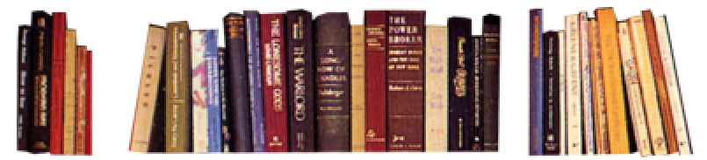
Language focus
Functional patterns
原句译文
我发现自己竟然在翻看她的诗歌和作文，欣赏着考卷上的高分，端详着她的名字……
逆译练习
I catch myself reading through poems and essays, admiring high scores on tests and reading her name, …. （L2, Para.6）
句型提炼
Notes:
47

Slide 48
Language focus
Functional patterns
句型提炼
Sb. catch oneself doing sth.
应用提示
用于表达“突然意识到自己在做某事”。
句型应用
Notes:
48

Slide 49
Language focus
Functional patterns
典型例句
当突然意识到自己犯了和他一样的错误时，她羞得满脸通红。
意群提示
( make the same mistake as he did / blush)
When she caught herself making the same mistake as he did, she blushed.

Slide 50
Language focus
Functional patterns
原句译文
我越理，要理的东西就越多。
逆译练习
The job grows larger the longer I am at it. (L2, Para.9)
句型提炼
Notes:
50

Slide 51
Language focus
Functional patterns
句型提炼
The more …, the more ….
应用提示
用于表达“越…… 越……”。
句型应用
Notes:
51

Slide 52
Language focus
Functional patterns
典型例句
读这本书越久，就越能领会其韵律和情感。
意群提示
(get into its rhythm and mood)
The longer you read this book, the more you get into its rhythm and mood.

Slide 53
Language focus
Functional patterns
原句译文
家里有她童年的纪念品在等着她。我们也在等着她，在张开双臂等她回来。
逆译练习
Tokens of her childhood will await her. So will we, with open arms. (L2, Para.22)
句型提炼
Notes:
53

Slide 54
Language focus
Functional patterns
句型提炼
sb. do sth. So/Neither/Nor will/do/does/did sb. else.
应用提示
用于表达“同样的情况也适用于其他人”。
句型应用
Notes:
54

Slide 55
Language focus
Functional patterns
典型例句
那次事故之后他父亲对他不报太高的期望了，他母亲也一样。
意群提示
(have great hope for )
His father didn’t have great hope for him after that accident. Nor did his mother.

Slide 56

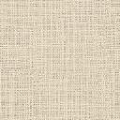
Language focus
Language appreciation
今天她走了，远离我去寻求成年人的独立。我很高兴她离开了。这意味着她成功了，而我也终于可以从18年的责任中脱身了。
a. Today she’s gone, off to be an adult far away from me. I’m glad she’s gone. It means she made it, and that I’m finally free of 18 years of responsibilities. (L1, Para.4)

Slide 57
Language focus
Language appreciation
他伤感的语气让我喉头一紧。我努力克制，不让眼泪流下来。
b. I feel my throat tighten at the sadness in his voice. I try hard to keep back my tears. (L1, Para.21)

Slide 58
Language focus
Language appreciation
家里有她童年的纪念品在等着她。我们也在等着她，张开双臂等她回来。
c. Tokens of her childhood will await her. So will we, with open arms. (L2, Para.22)

Slide 59
Critical thinking
Theme exploration
If you were the daughter, what response
would you have when you read the article?
Some young people refuse to take their parents’ advice or even do the opposite as they think they are adults. How do you think about it?
Some say a good relationship starts with good communication. What can you do to strengthen communication with your parents?

Slide 60

Critical thinking
Theme exploration
If you were the daughter, what response would you have when you read the article?
Tips
If I were the daughter, I would be very much touched when I read the article. I would call my mom to say sorry for acting rebelliously and would tell her how much I love her. Probably I would return home as soon as I can.

Slide 61
Critical thinking
Theme exploration
2. Some young people refuse to take their parents’ advice or even do the opposite as they think they are adults. How do you think about it?
\\
Tips
I don’t think it is wise to refuse parents’ advice or even do the opposite without a good reason. Your parents care about you more than anybody else and always want to share their experience with you. If you follow their advice, you can at least learn from their experience and avoid making silly mistakes. If you don’t take their advice, you may still get experience – but in a hard way. Besides, your parents may directly point out your weaknesses that your peers wouldn’t. So, listening to your parents’ advice can make you smarter and help you grow mature.

Slide 62
Critical thinking
Theme exploration
3. Some say a good relationship starts with good communication. What can you do to strengthen communication with your parents?
Tips
Good communication will, in my view, help build a good relationship. The following are my ways to strengthen communication with my parents:
• Visit them whenever possible;
• Invite them to see what I am doing at college;
Teach them to use new communication tools, such as WeChat and Skype so that they can communicate with me wherever I am;
• Try to look at things in their perspectives; and
• Share with them my feelings, problems or ambitions.

Slide 63

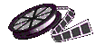
Critical thinking
Watching & discussing
Watch a video clip and discuss the question:
What’s the parenting style of the tiger mother?

Slide 64
Critical thinking
Watching & discussing
What’s the parenting style of the tiger mother?
Tips
On the one hand, being the second generation immigrant living in America, the tiger mother was brought up under the strict rules set by her parents. She hopes to raise her children the way she was raised. So she is very strict with her daughters and demands excellence from them.

Slide 65
Critical thinking
Watching & discussing
What’s the parenting style of the tiger mother?
Tips
On the other hand, she tries to counterbalance it by giving her children some freedom and space and providing a free and relaxing nurturing environment for her children.

Slide 66
Critical thinking
Culture exploration
What are the differences between the traditional Chinese parenting style and the western parenting style? Which one do you prefer?
Tips
Firstly, Chinese parents often have high expectations for their children who are thus under great pressure. While the American parents don’t emphasize much on children’s schoolwork and the children enjoy much more freedom and fun than the Chinese kids.
Secondly, many Chinese parents view their children as their products, treating them as objects and trying to mold them into the forms they wish the children to be. While the American parents pay more attention to children’s individual personality and care more about their happiness.

Slide 67

A child’s clutter awaits
an adult’s return
Section A
Language application
Writing devices
Essay writing
Paragraph translation

Slide 68
Writing devices
Sentence writing
Absolute structure consists of a noun plus at least one other word, such as an adjective, a prepositional phrase, adverbs or participles. 独立结构一般由“名词 + 形容词/ 分词/ 介词短语”构成。
Example:
She left the bedroom a ridiculous mess, the comforter on the floor, the sheets tossed aside. (Para. 11)

Slide 69
Writing devices
Sentence writing
Appreciation
I． 名词+现在分词
An old man was standing before them, his wide, pale eyes shining like moons through the gloom of the shop. (From Harry Potter and the Philosopher’s Stone)
一个老人站在他们面前，他大而发青的眼睛透过小店的昏暗闪着光。

Slide 70
Writing devices
Sentence writing
Appreciation
II.名词+介词短语
Harry and Ron barely had time to exchange mystified looks before she was dashing back, an enormous old book in her arms. (From Harry Potter and the Philosopher’s Stone)
哈利和罗恩还没有回过神来，她便抱着一堆书，冲了回来。

Slide 71
Writing devices
Sentence writing
Appreciation
III.名词+过去分词
… the next second, Harry had pulled out of the dive, his arm raised in triumph, the Snitch clasped in his hand. (From Harry Potter and the Philosopher’s Stone)
……紧接着，哈利停止了俯冲。他胜利地举起手臂，飞贼被他紧紧地抓在手里。

Slide 72
Writing devices
Sentence writing
Appreciation
IV. 名词+形容词
Come on, run, run! Harry yelled at Hermione, trying to pull her toward the door, but she couldn’t move, she was still flat against the wall, her mouth open with terror. (From Harry Potter and the Philosopher’s Stone)
过来，快跑，快跑！哈利朝赫敏喊道，想把她拉向门口，但是她动弹不得, 仍然紧紧地贴在墙上，嘴巴惊恐地张得老大。

Slide 73
Writing devices
Sentence writing
Practice
a. 孩子们正在院子里堆雪人，在寒冷的空气中哈出一团团白气。(n. + adj.)
Translation: _______________________________
_________________________________________
The children were building a snowman in the yard, their breaths white in the cold air.
b. He left the room, _________________________ _______ (n.+V-ing) (他鼻子里流着血，双手颤抖着).
his nose bleeding, his hands shaking

Slide 74

Writing devices
Paragraph writing
Problem
Details of the Problem
Solution
Evaluation

Slide 75
Writing devices
Paragraph writing
Example:
She left a mess. (Problem) Her bathroom is an embarrassment of damp towels, rusted shaving blades, hair in the sink, and nearly empty tubes of toothpaste. (Details of the Problem) I bring a box of big black garbage bags upstairs. Eye shadow, face cream, nail polish – all go into the trash. I dump drawers, sweep shelves clear and clean the sink. (Solution) When I am finished, it is as neat and impersonal as a hotel bathroom. (Evaluation)

Slide 76

Writing devices
Paragraph writing
Writing practice
Directions: Read the sample paragraph and see how it develops in the problem-solution pattern.

Slide 77
Writing devices
Paragraph writing
Topic: How to keep a good relationship with children
Problem: Many parents do not seem to know how to keep a good relationship with their children.
Details of the problem: They do not know what activities to do or what topics to talk about with their children.
Solutions:
Have a family trip.
Do fun things together.
Tell stories to young children.
Evaluation: All these will contribute to a better relationship with children.

Slide 78

Writing devices
Paragraph writing
Sample paragraph:
Many parents do not seem to know how to keep a good relationship with their children. (Problem) They do not know what activities to do or what topics to talk about with their children. (Details of the problem) Here are a few useful tips. Having a family trip sometimes is a wonderful way for all family members to bond together.

Slide 79
Writing devices
Paragraph writing
Sample paragraph:
And you and your children can do fun things together, for example, playing football or watching their favorite show. Besides, a very good activity to bond with your young children is storytelling! You can tell them the stories you heard from your parents or stories about your childhood. (Solutions) All these ways will contribute to a better relationship with your children. (Evaluation)

Slide 80

Writing devices
Paragraph writing
Writing practice
Directions: Write a paragraph on one of the following topics. One of the topics has an outline you can follow.

Slide 81
Writing devices
Paragraph writing
Topic: What to do when your parents are disappointed with you
Problem:
Parents may be disappointed when you fail to meet their expectations.
Solutions:
Make your parents believe that you are a responsible person.
• Tell them you have inherited many of their merits.
• Remind them that you have your own life goals as an individual.
• Explain how your lifestyle will help you in a positive way.
Evaluation:
This may not change their opinions overnight, but eventually it will work.

Slide 82
Writing devices
Paragraph writing
What to do when your parents are disappointed with you
Parents may get disappointed when you fail to meet their expectations. They may strongly object to your lifestyle and complain that you are wasting time on unimportant things. (Problem) To solve this problem, you may try to make them understand that you are a responsible person.

Slide 83
Writing devices
Paragraph writing
First tell them that you have inherited many of their merits. Then remind them that you also have your own thoughts and life goals as an individual. You can also explain how your lifestyle will influence you in a positive way. (Solutions) You may not be able to change your parents’ opinions overnight, but if you keep trying, it will eventually work. (Evaluation)

Slide 84
Writing devices
Paragraph writing
More topics:
• How to get rid of cheating in schools
How to deal with peer pressure

Slide 85

Essay writing
Write an essay on the following topic.
Suppose you were the daughter in the text who was to leave home for college. Write an essay titled “A baby no more, an adult already” illustrating the change of your emotion on the way striving for independence. You may apply as many expressions from the text as possible to your writing.

Slide 86
Essay writing
You can follow the outline given below.
Part I: I (the daughter) pack the luggage and get ready for college.
1. The mess I leave in my bathroom and bedroom;
2. What I feel at that particular moment (glad for being finally free, can’t wait to leave, striving for independence);

Slide 87
Essay writing
You can follow the outline given below.
Part II: I feel sad when I see the gifts my parents sent me.
1. The gifts parents sent me and the power I once gained from them;
2. What I do with these gifts (put them in an envelope and mark it with words);

Slide 88
Essay writing
You can follow the outline given below.
Part II: I leave home in my new car.
1. The disagreement between Mom and me on what vehicle to buy;
2. My guilt for the rebellion and my reluctance to leave home.

Slide 89
Essay writing
You may adopt the following expressions.
I am earning myself …,
pass from …to …,
I catch myself doing …,
pack …into…,
for free …,
after all,
reverse myself,
keep back one’s tears
leave a ridiculous mess,
be filled with,
filed by year and subject,
toss aside,
throw away,
straighten up
be finally free of …,
be finished,

Slide 90
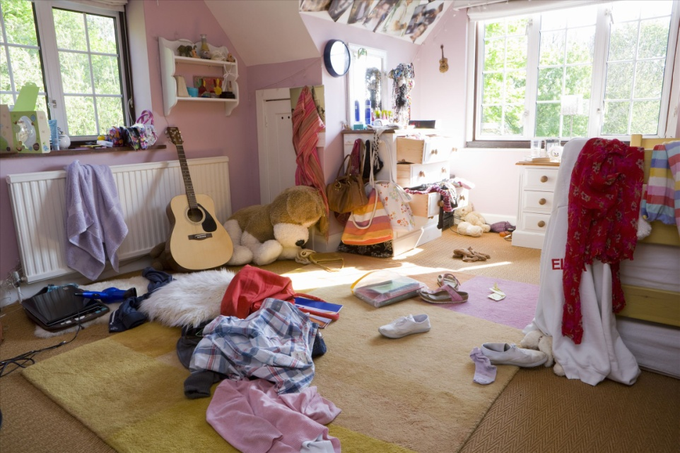
Paragraph translation
Translate a paragraph based on a summary of the text by using the expressions from the text.

Slide 91
Paragraph translation
看着女儿倒车离开，我心里感到高兴，终于摆脱对她的责任了。她的卧室里一片狼藉，床上和地上到处是她随意扔掉的衣物，书桌上摆着各种书，抽屉里塞满了按年代和主题归类的试卷。
back one’s car
be free of
leave a mess
toss aside
be filled with
be filed by year and subject

Slide 92
Paragraph translation
我花了很长时间来整理她的房间, 计划着将它改成一间漂亮客房。突然，一个写着“不要丢弃”的大信封吸引了我的注意力。打开一看，里面装着以前我们送给女儿的书信、贺卡和杂志上剪下的漫画，这些都是她童年的纪念品。
straighten up
turn … into
be marked with
capture one’s attention
clip
tokens of the childhood

Slide 93
Paragraph translation
reverse my mind
我改变了主意, 忍着眼泪将衣服摆回了原处。这些童年的纪念品会等着女儿回来，我们也会张开双臂等待她回家。
keep back one’s tears
await
with open arms

Slide 94
Paragraph translation
Watching my daughter back her truck and drive away, I feel glad for being finally free of the responsibilities for her. She left a mess in her bedroom. There are clothes she tossed aside everywhere on the floor and various books on her desk. And the drawers of the desk are filled with papers filed by year and subject. I spend quite a long time straightening up her room and think about turning it into a fancy guest room.

Slide 95
Paragraph translation
Suddenly, a large envelope marked with “DO NOT THROW AWAY” captures my attention. As I open it, I find inside the envelope there are letters, greeting cards and comics clipped from magazines, which are all our gifts to her and tokens of her childhood. I reverse my mind. I try hard to keep back my tears and put the clothes where they were. Tokens of her childhood will await her. So will we, with open arms.

Slide 96


A child’s clutter awaits
an adult’s return
Section A
Summary
Revision of
the useful expressions
Thematic study
Revision of
the functional patterns

Slide 97
Revision of
the useful expressions
Language points — Useful expressions
1 倒车
2 省油的实用型汽车
3 成功了
4 免于/摆脱了
5 做完……
6 按年代和主题归类
7 右上角
8 扔掉
back one’s car
a practical car with good gas efficiency
make it
be free from/of
be finished (with …)
be filed by year and subject
in the upper right-hand corner
throw away

Slide 98
Revision of
the useful expressions
Language points — Useful expressions
9 将房间搞得一片狼藉
10 扔在一边
11 将硬币投进洗衣机
12 免费提供
13 改变主意/态度
14 收拾
15 抑制住眼泪
16 热情地
leave the room a ridiculous mess
toss aside
feed coins into laundry machines
provide sth. for free
reverse oneself/one’s attitude
straighten up
keep back one’s tears
with open arms

Slide 99
Revision of
the functional patterns
Language points — Useful patterns
Functions & Usages | Sentence Patterns
用于表达“突然意识到自己在做某事”。
2. 用于表达“越…… 越 ……”。
3. 用于表达“同样的情况 也适用于其他人”。
Sb. catch oneself doing sth.
The more …, the more ….
Sb. do sth. So/Neither/Nor will/do/does/did sb. else.
Notes:
上面挤，下面空

Slide 100


A child’s clutter awaits
an adult’s return
Section A
The End

